Slide 1
Basic Electrical Theory

Slide 2
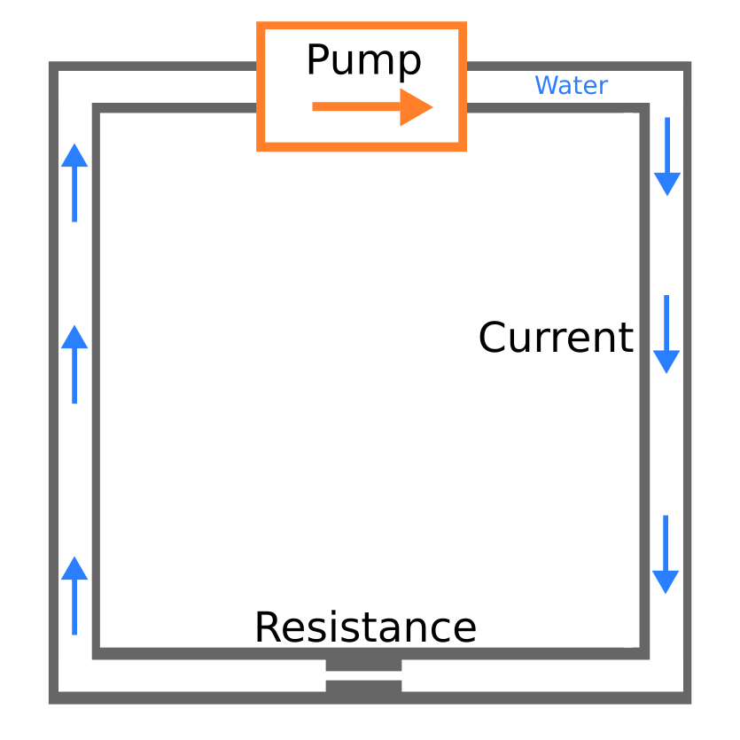
V=voltage Volts
R=resistance Ohms
I=current Amps
I=V / R

Slide 3
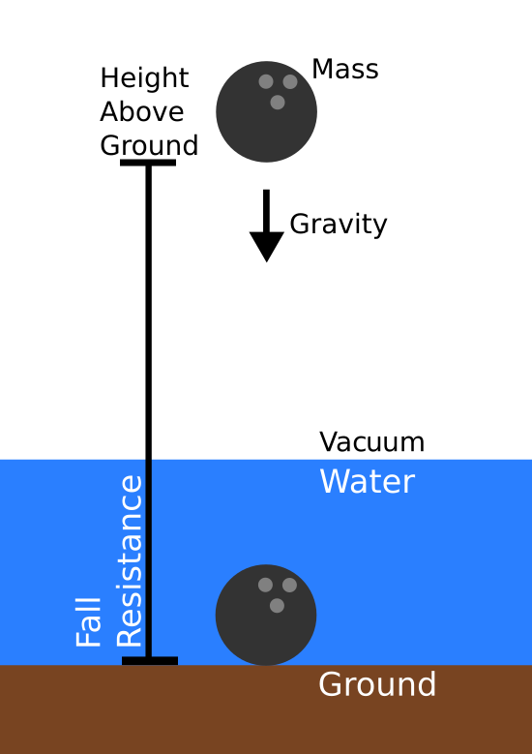
What is voltage?
Gravity Potential = E = m * g * h
E / m = g * h = Joules per gram
Voltage = Joules per Coulomb
Voltage = Energy per unit charge
Current = Coulomb per sec

Slide 4
What is voltage?
A ball dropped from higher has more energy to dissipate into the water surface
Similarly, an electron passing through an LED from a 12V source will have more energy to dissipate compared to a 1.5V source. So use an appropriate resistor to absorb excess energy.

Slide 5
What is Power?
V = Joule / Coulomb
I = Coulomb / Sec
V * I = Joules / Sec = Power in Watts
This is how much energy is supplied, absorbed, or converted into heat

Slide 6
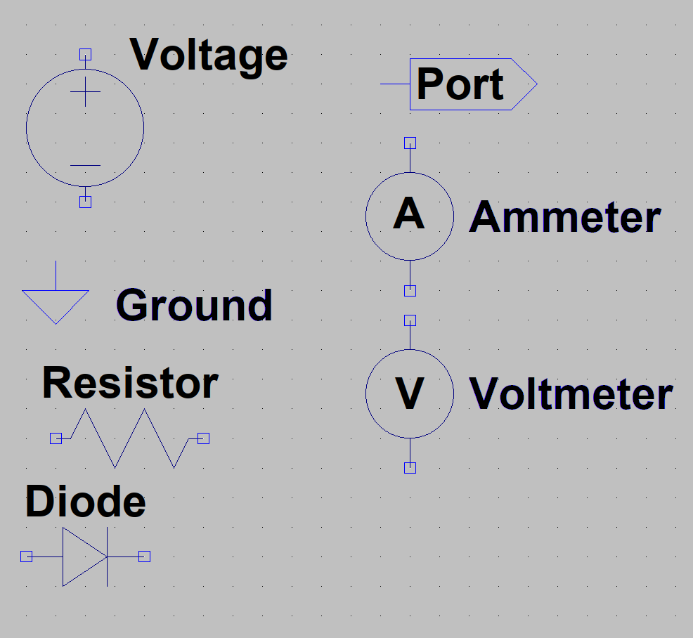
Basic circuit symbols

Slide 7
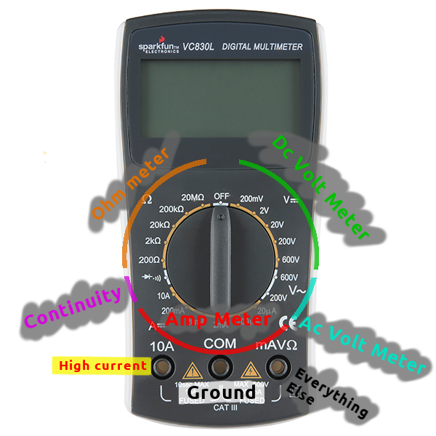
Practice: Voltmeter
Learn to use multimeter, breadboard, & Arduino as voltmeter

Slide 8
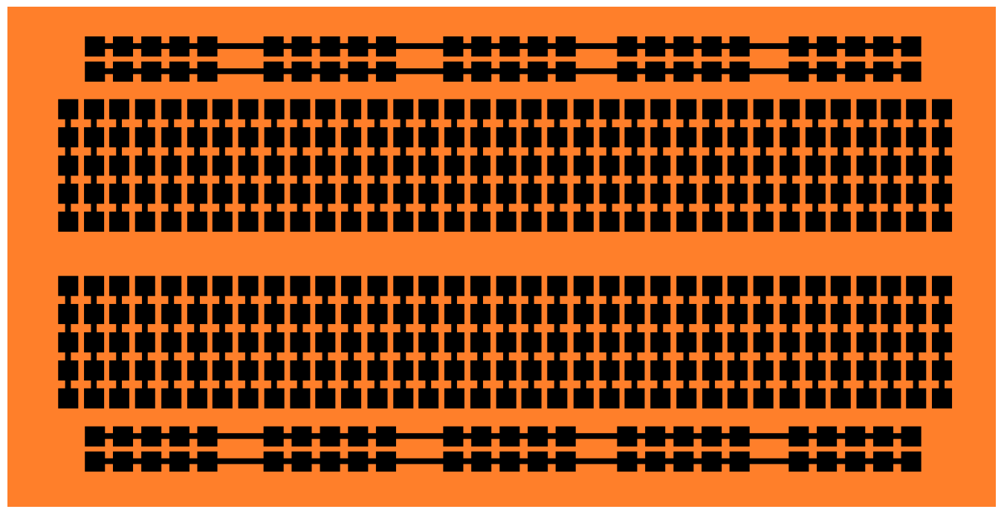
Practice: Breadboard

Slide 9
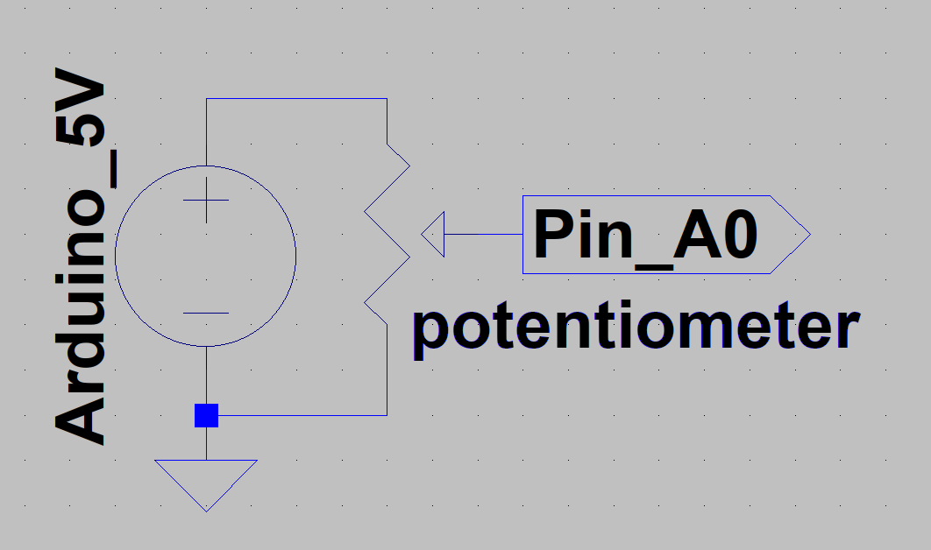
Practice: Circuit

Slide 10
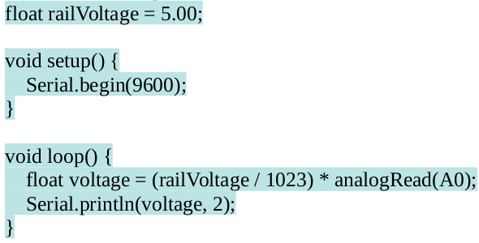

Practice: Procedure
Construct circuit
Open Arduino IDE
Write code
Upload
View in port

Slide 11
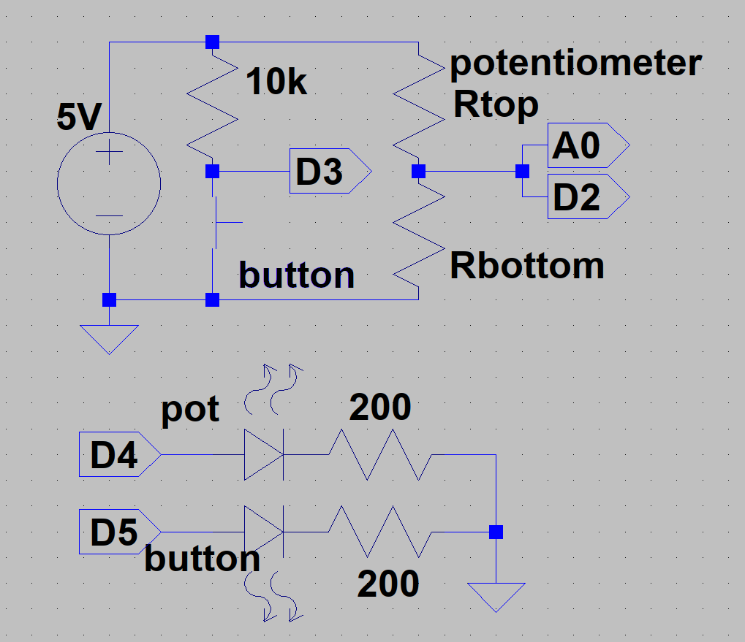
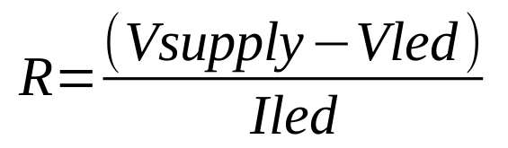
Practice: LEDs & Buttons (Digital Logic)
(5V – 2V) / 20mA =150 Ohms
150 Ohm is minimum, we’ll use 2 X 100 Ohms from our kit.
(Brn, Blk, Brn)

Slide 12
Practice: LEDs & Buttons (Digital Logic)
Button is just a wire when pressed, so use a high resistance to avoid damaging the Arduino. In our case 10Kilo Ohms.
(Brn, Blk, Orng)

Slide 13
Practice: LEDs & Buttons (Digital Logic)
Construct circuit
Open Arduino IDE
Open TTL Visualizer program
Upload
View in port

Slide 14
Practice: LEDs & Buttons (Digital Logic)
Arduino and most computing devices are digital to the core. Every signal & computation are digital and so all information must be encoded digitally for Arduino to handle. This example shows what the cutoff points for a digital HIGH and LOW are.

Slide 15
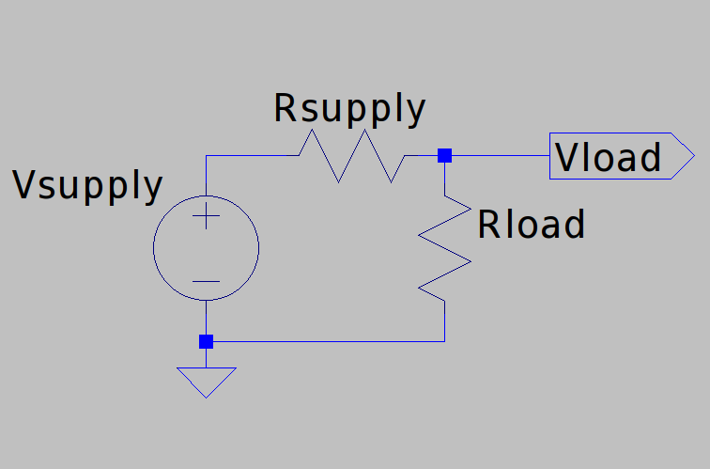
Powering Devices: Imperfections
All supplies have internal resistance
Batteries lose voltage while in use
This varies voltage seen by any device

Slide 16
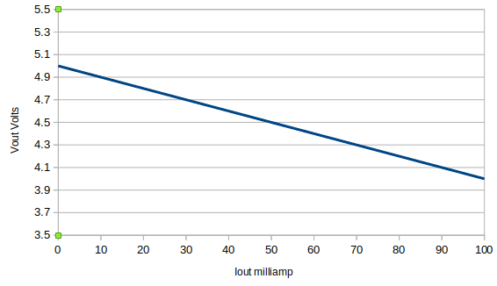
Powering Devices: Imperfections
10 Ohm supply resistance, powering at different amps

Slide 17
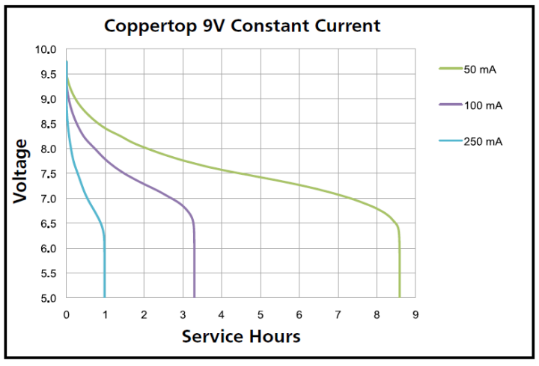
Powering Devices: Imperfections
How voltage drops on a battery

Slide 18
Powering Devices: Regulators
Linear Regulators
  Absorb excess voltage as heat
  Only outputs lower voltages than input
  Simple to use
  Efficiency depends on current draw
Switching Regulators
  Uses magnetic & electric field as power buffer
  Comes in many varieties
  Can be extremely power efficient

Slide 19
Powering Devices: Regulators
Switching Regulators
  Buck – Output voltage lower than input (most efficient)
  Boost – Output voltage higher than input
  Buck/Boost – Output voltage higher OR lower than input (least efficient)

Slide 20
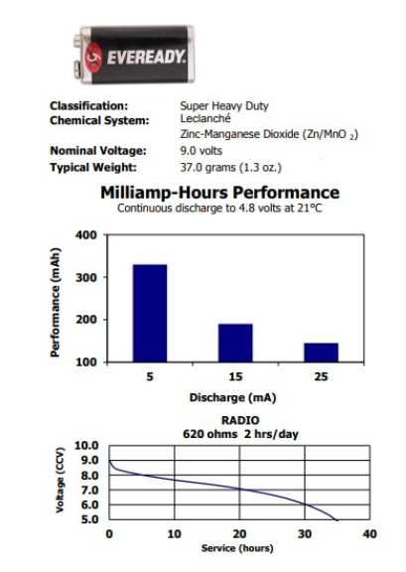
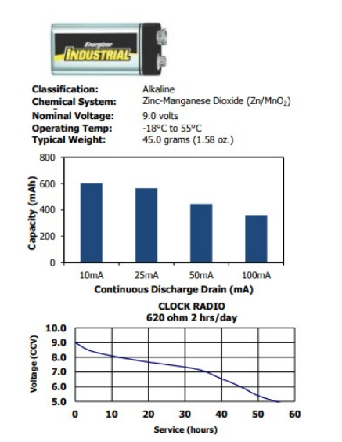
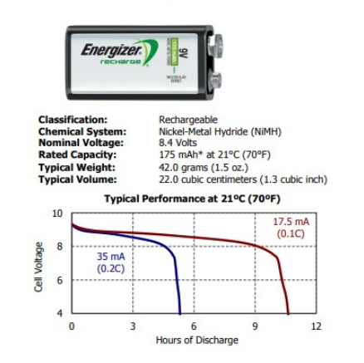
Powering Devices: Batteries

Slide 21
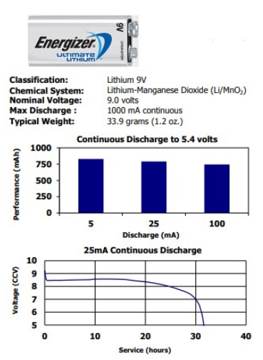
Powering Devices: Batteries

Slide 22
Powering Devices: Our Requirements
3 Hour Flight
Assume 100mA
3hrs * 100mA = 300mAH
Lithium 9V is best fit

Slide 23
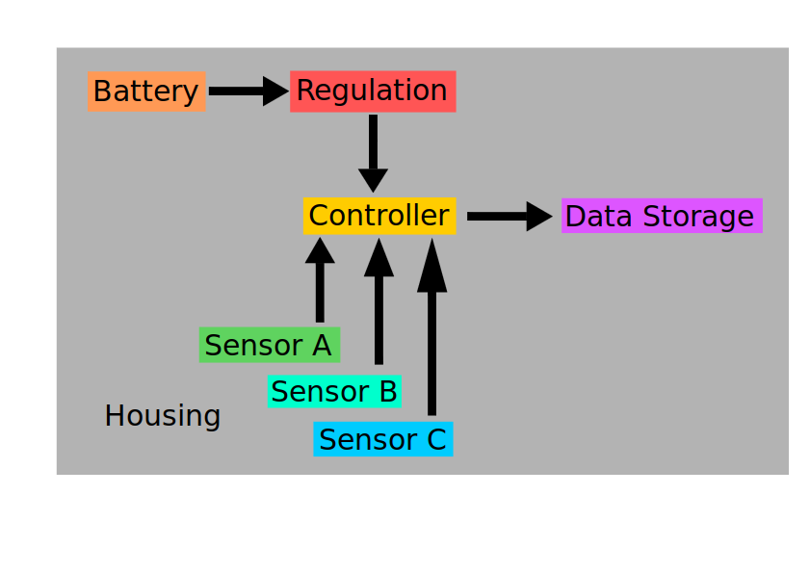
Design: Blank

Slide 24
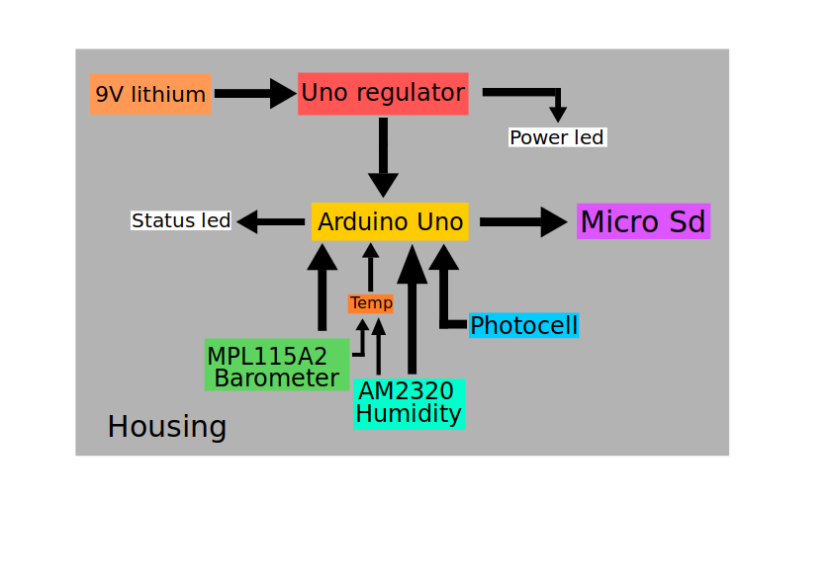
Design: Defined

Slide 25
End of day
Tomorrow we build this example payload & dive deeper

